Slide 1
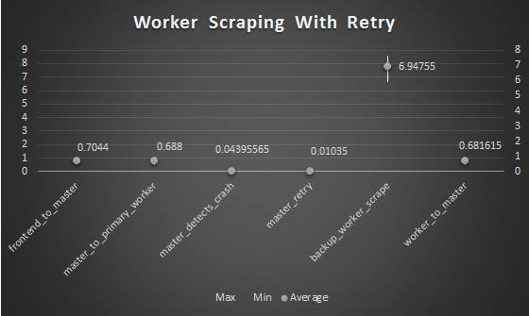
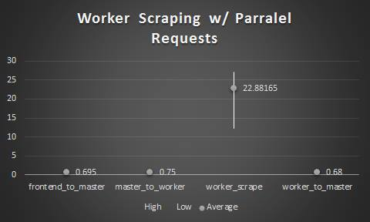

Health.Mate
Joshua Antonson, Aayush Agarwal, Mikhail Kutsovsky, Priya Narasimhan
Introduction and Problem Statement
Architecture and Fault Tolerance
As the world becomes more flat, individuals are accessing several more hospitals than before. This leads to scattered personal health records which is unpractical for self-management.
Health.Mate allows users to maintain a centralized location to view and add to their collection of personal health files.
Goals
Usability – create a secure account, collect health records from medical providers, view records whenever
Fault-Tolerance – a system which is able to withstand servers or databases going down in the back-end of the applciation
Non-goals
We did not replicate our back-end workflow coordinator.
Our system is entirely deployed on AWS and has the following components:
Web Server – Serves as the user interaction layer to our application, this is the only box which allows for “public” requests
Master Server – our single point of failure, acts as the coordinator for requests from front-end to workers
Worker Server – communicates with the hospital’s severs to access files and then writes files to our own secure database
Database – passively replicated MongoDB instances in AWS which get files from workers and sends PDFs to front end
Experimental Evaluation
The top graph shows average time of all operations required for case when a worker server crashes in the middle of processing a request
The bottom graph shows the performance of each of the servers when handling concurrent requests
Demonstration
Access your own health files
If you are a myUPMC user, you can create an account on health.mate and enter your myUPMC credentials to view your current health files
Kill one of our servers
Start a request to collect health files and kill the machine which is doing the work
Your architecture diagram goes here (please remove this box)
Fault Tolerant Distributed Systems @ Carnegie Mellon

